Slide 1

DESIGN THINKING AND INNOVATION
Dr D. Venkata Subbaiah
Professor, Computer Science & Engineering Department
Lakireddy Bali Reddy College of Engineering (A), Mylavaram

Slide 2
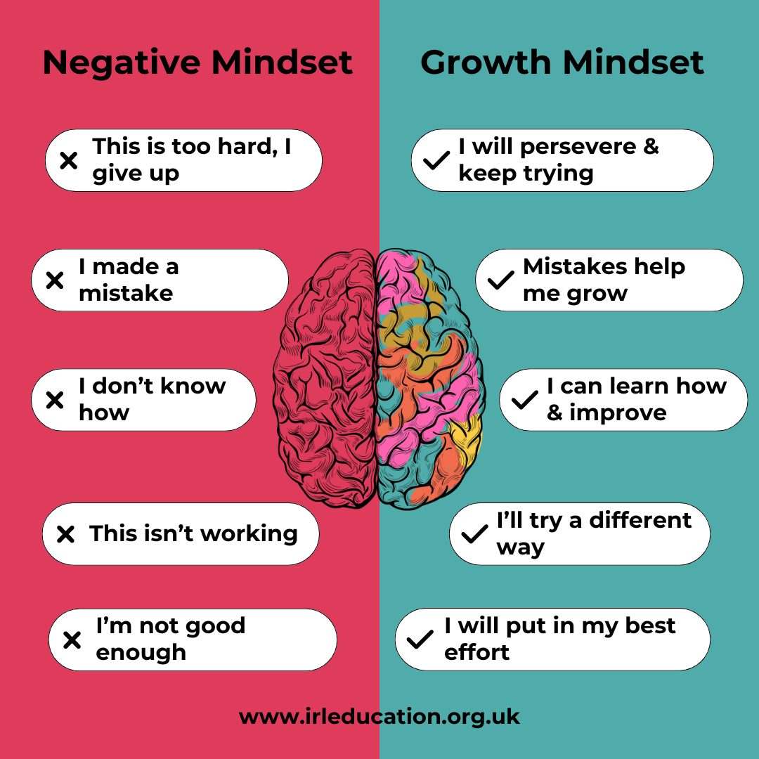
Concept of Design Thinking

Slide 3
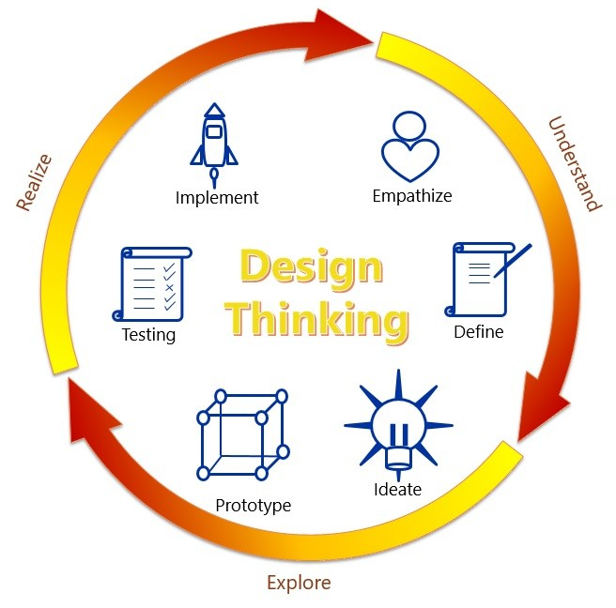
Elements of Design Thinking
6
1
5
2
4
3

Slide 4
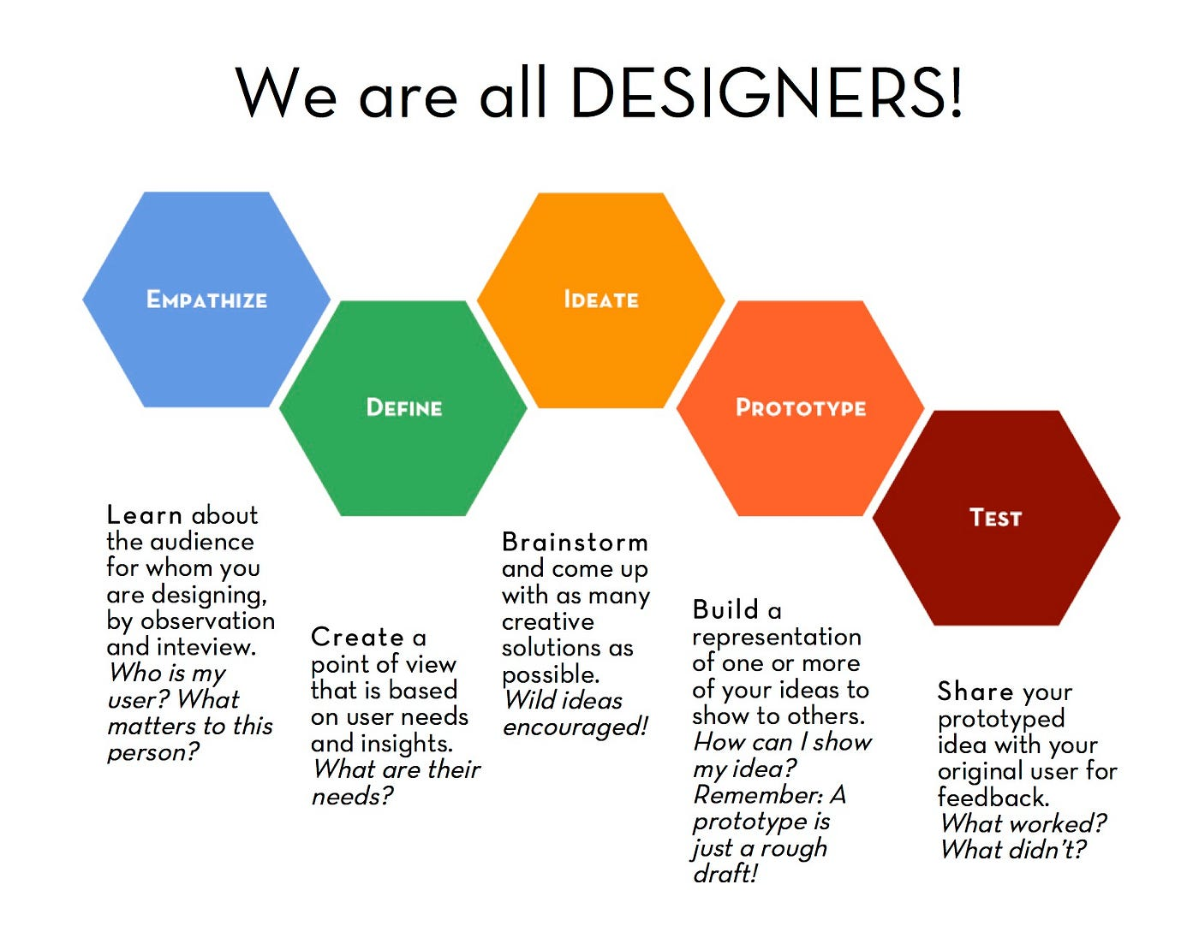
Elements of Design Thinking
INSIGHTS
NEEDS
CONCEPTS
MODELS
REFINE

Slide 5
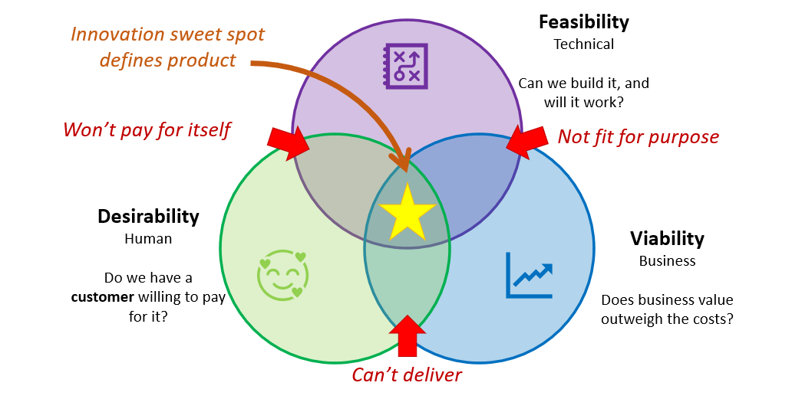
Elements of Design Thinking
Innovation/Outcome

Slide 6
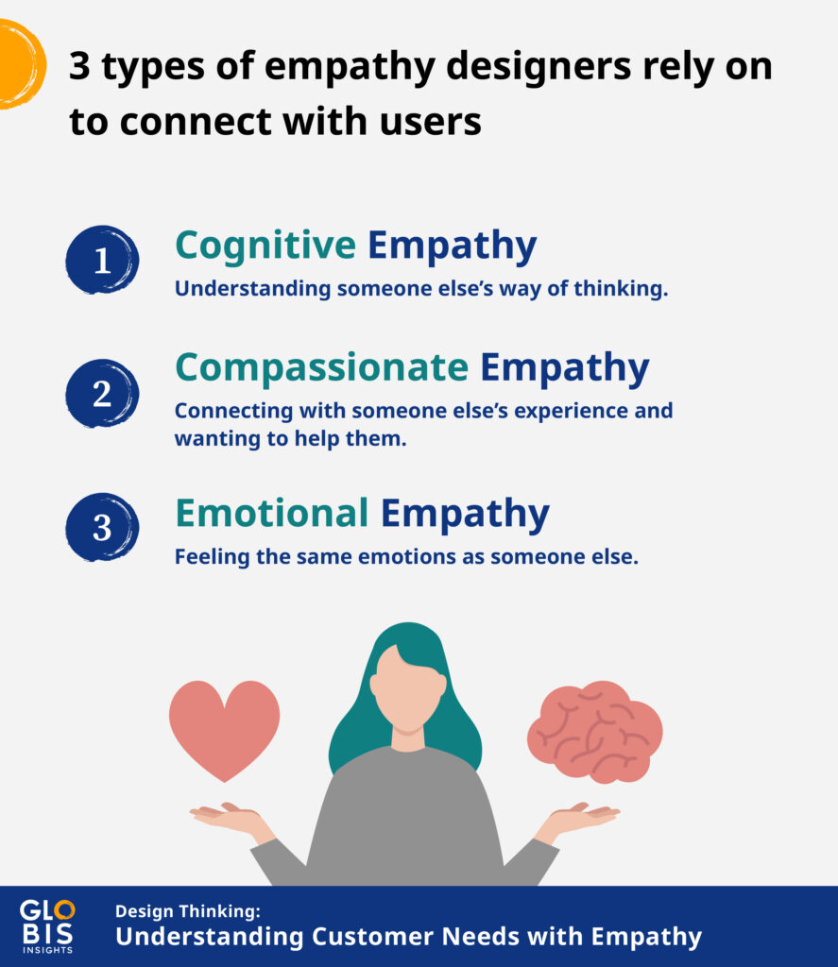
Elements of Design Thinking: Empathy
EMPATHY: Ability to understand and share the feelings of others

Slide 7
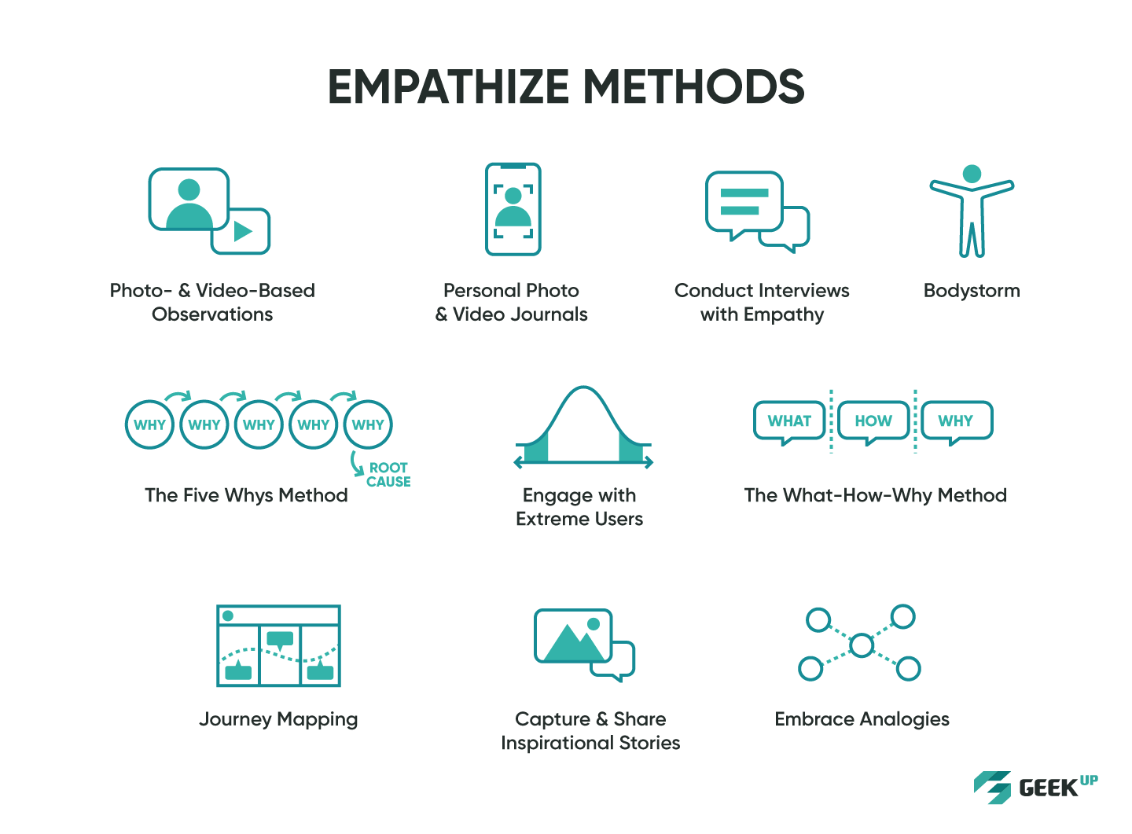
Elements of Design Thinking: Empathy
EMPATHY: Ability to understand and share the feelings of others
OBJECTIVE:
To develop INSIGHTS of Customer

Slide 8
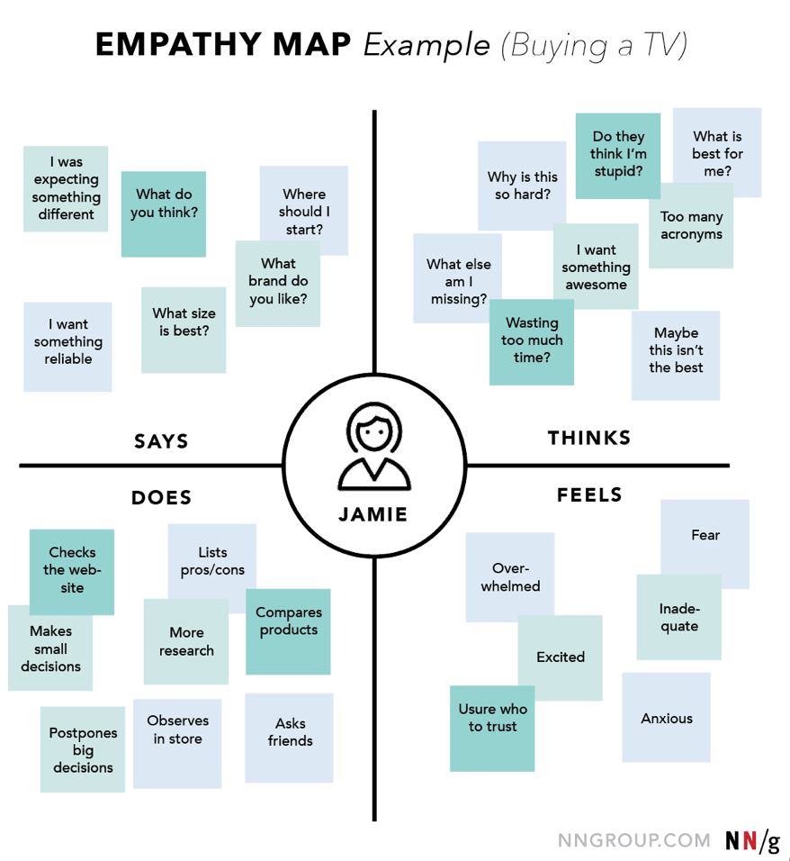
Elements of Design Thinking: Empathy

Slide 9
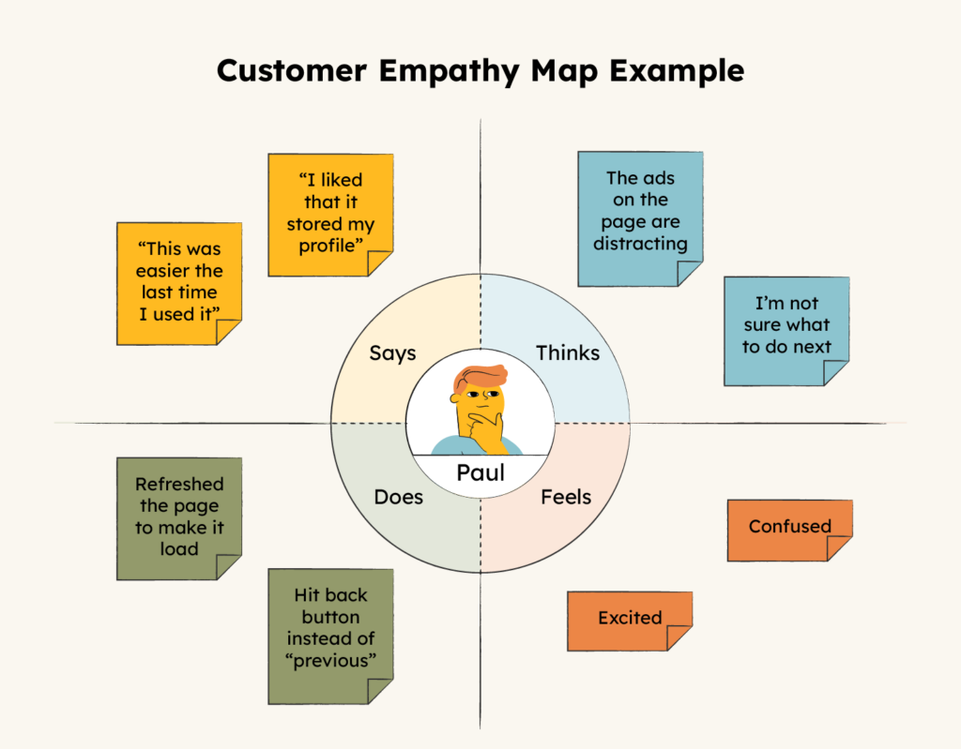
Elements of Design Thinking: Empathy

Slide 10

Elements of Design Thinking: Empathy
Problem Identification Strategies
From day-to-day life
Observations in surroundings
Taken up in Hackathon Projects
Open-ended ideas
Ideas should be popped out of thinking, need and necessity
Key points of Empathize to Remember and generate Insight of Problem
Observe
Interview
Interaction
Engage

Slide 11


Elements of Design Thinking: Empathy
Interview of Customer
Focused Interview
Skilled/Group Interview
Focus on the problems of the Users

Slide 12
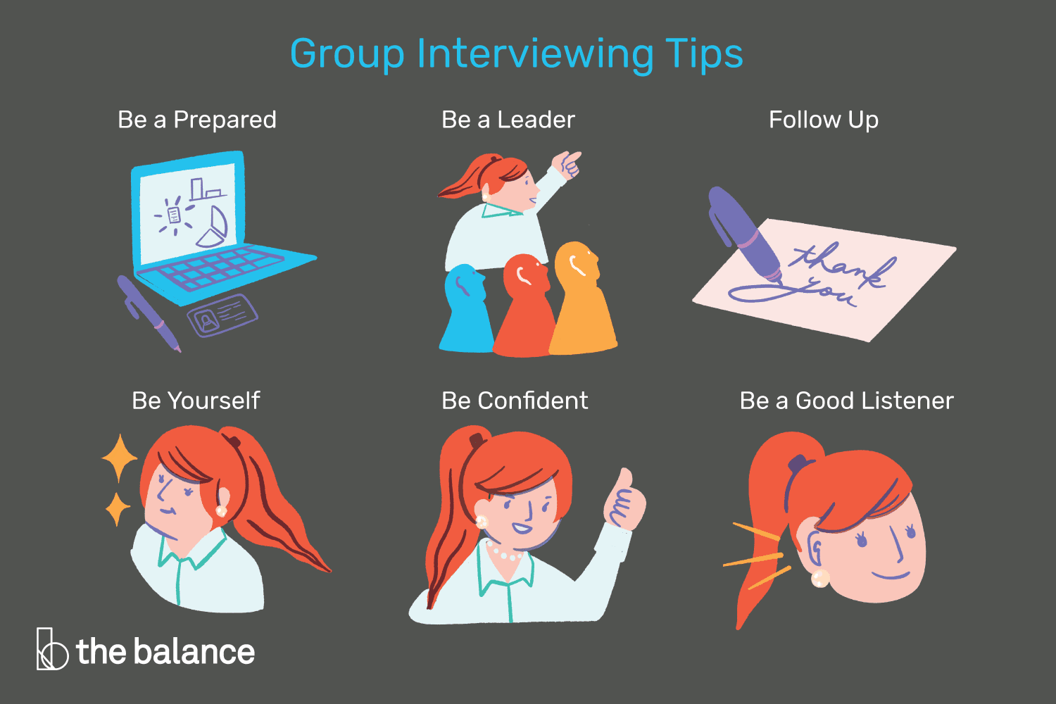
Elements of Design Thinking: Empathy
Interview of Customer
Focused Interviews
Objective measures of behaviors
Minimizes bias of interviewer
Common language and template used across different assessors
Gets data beyond the normal knowledge and skills level
Proven to differentiate between outstanding and average performance

Slide 13
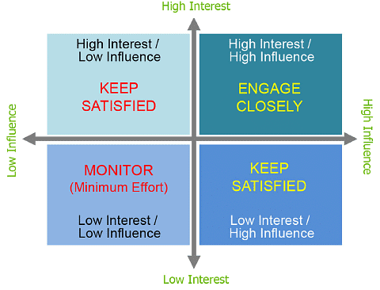
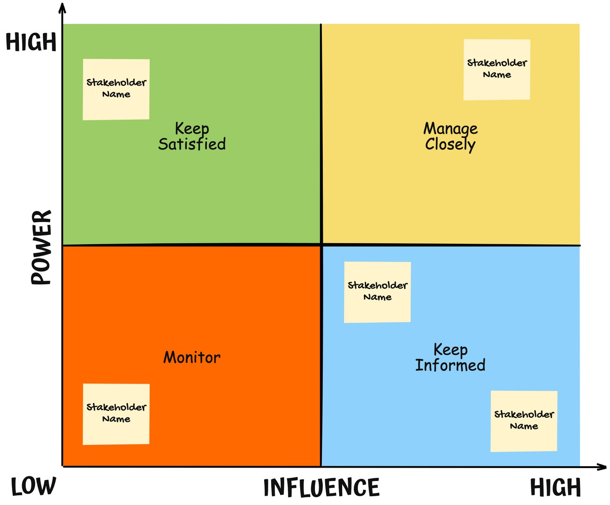
Elements of Design Thinking: Empathy
Objective: Develop the Power vs Interest Matrix for each Stakeholder to identify their role in the problem

Slide 14
Elements of Design Thinking: Empathy - Stakeholders
Customers – The customers for your product or service. These are the people you want to sell to and make money from.
Employees – Your employees are also stakeholders as they are directly involved with delivering the project results.
Suppliers – Your suppliers are also stakeholders because they provide materials, services, or equipment required by the project.
Investors – Investors are interested in seeing the project succeed so they can recoup their investment.
Partners - Partners are also stakeholders as they have a vested interest in the outcome of your project.
Government - Government organizations such as councils, government departments, state agencies, etc., are stakeholders because they directly influence the project's outcomes.
Public - Public organizations like schools, hospitals, libraries, museums, community centers, sports clubs etc., are stakeholders because the public uses these facilities.
Other organizations – Any other organization that has an interest in the project's success.

Slide 15
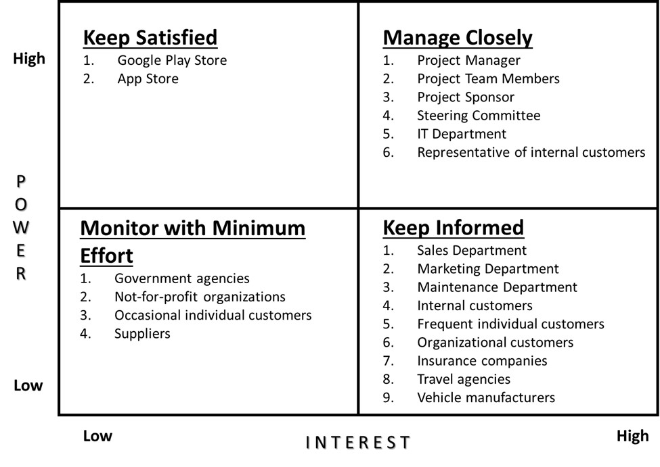
Elements of Design Thinking: Empathy
Example of a Typical Power Vs Interest Matrix problem and key Stakeholders involved

Slide 16
Elements of Design Thinking: Empathy
ACTIVITIES
Interview of an User
Activity | Action Plan | Observations
Interview of an User | Take any problem and identify all the Stake holders in the problem Develop a Power vs Interest matrix for all the Stakeholders involved Develop a questionnaire for a problem based on the user perspective such as Passenger, Branch Manager, HOD, Chief Superintendent etc. Conduct a one-on-one sample interview of any two Stake holders. If possible record the interview through Audio or Video. List out all the responses. Identify the major problems (3-5) from the all responses | Listening, Observations, Empathize with Customer, Understanding their actual problems and their intensity, Analysis of the responses, Proper Interview process with structured questions

Slide 17

Elements of Design Thinking: Empathy
ACTIVITIES
Traffic Congestion Problem
Observe the photograph and list out all the observations and analyze

Slide 18


Elements of Design Thinking: Empathy
ACTIVITIES
School Children leaving the school
Observe the photograph and list out all the observations and analyze

Slide 19



Elements of Design Thinking: Empathy
ACTIVITIES
Design a wallet using paper and gift it to other team
Observations: Interaction with Customer, Checking his requirements, Choices, Preferences, and developing the product as per the requirements

Slide 20


